Slide 1
Never Let Me Go
Lesson 8

Slide 2
Lesson Objective
At the end of this lesson we will have discussed issues of humanity presented within the novel.

Slide 3
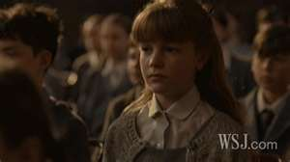
Starter
In chapter 7, a comparison is made between Hailsham and a ‘prison camp’. To what extent can this comparison be supported or denied?

Slide 4
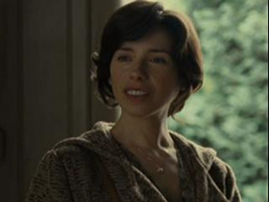
‘It’s just as well the fences at Hailsham aren’t electrified. You get terrible accidents sometimes’ – Miss Lucy (p77)

Slide 5
What does this tell us about (a) the students lives and (b) Miss Lucy’s personal opinion
Do a close reading of Miss Lucy’s speech to the students, starting on page 78 with ‘No, no, I’m sorry…’ and going to page 80 with ‘you have to know who you are and what lies ahead of you, every one of you.’

Slide 6
Analysing Language…
‘…you don’t mean any harm…’
‘…it’s been allowed to go on, and it’s not right…’
‘You’ve been told, but none of you really understand…’
‘…some people are quite happy to leave it that way…’
‘Your lives are set for you…’
‘…created to do…’
‘…for a purpose…’
‘…you have to know who are you and what lies ahead of you.’

Slide 7
What makes us human? Can the students be classed as human, or are they intended to be something different?
Humanity

Slide 8
They ‘smuggle into our heads a lot of the basic facts about our future…’ (p80)
Kathy admits that most students like to remain ignorant to the specifics of their futures. Why might they do this?
Do you agree with the school policy to be vague when discussing their fate? Why is it easier to do things this way?

Slide 9
Chapter 7 Questions
How is sex dealt with at Hailsham? Consider how Miss Emily teaches the students about sex.
She says that they can have sex with people ‘out there’. Do you think this happens often?
Kathy refers to discussions of donations as uncomfortable ‘territory’, ‘that ground’, the ‘whole area’ and ‘these things’. What do these words suggest about how she, and the others, feel about donations?

Slide 10
Tommy
Consider the ‘elbow’ incident. What does this tell us about Tommy?
It is through the teasing of Tommy that we learn more about what donating actually entrails; the harvesting of body parts. What are your initial reactions to this revelation? Is it fair? Ethical? Humane?
Tommy appears to have a different relationship with Miss Lucy. He feels some sympathy for her. Do you think she deserves it? Is she blameless?

Slide 11
TASK
Imagine you are Tommy. Write a diary entry in which you reflect on how you felt upon learning that ‘unzipping’ yourself to make donations was a cruel joke.

